Slide 1

THE ECONOMY
AND DEMOGRAPHICS
Policy Studies for Educational Leaders, Fowler, 2013
Presented by Luis Alaniz
In partial fulfillment of EDUL-8342

Slide 2

Big Questions
Why does the economy and demographics matter to education?
Why should educational leaders be tuned in to such changes?

Slide 3
Time
Policy does not emerge out of nowhere; policy is created by and in response to social settings. Knowing what comes next gives you time to plan for the future.

Slide 4
Local changes in K-12
Responses
______________________
______________________
______________________
______________________
Challenges
The rise of charter schools
Shifting demographics
Changes in birth rates
Employment rates

Slide 5
Higher-ed?

Slide 6
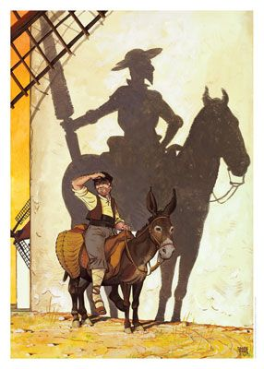
Policy and its social context
Policy operates within the bounds of
  The economy
  Social trends
  Politics
  Demographics
Knowing the present-day reality matters
This Photo by Unknown Author is licensed under CC BY-SA-NC

Slide 7
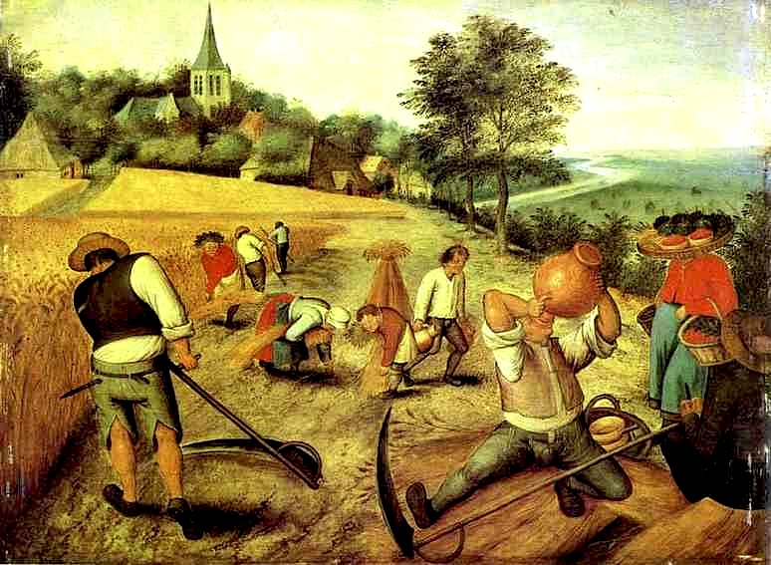
The Economic Environment
Two big components: structure and climate
  Both ebb and flow
There have been large changes since colonial America where government regulations were high and institutions like slavery were still present
This Photo by Unknown Author is licensed under CC BY-SA-NC

Slide 8
The History of the U.S. economy cont.
Period | Happenings
Bush and Clinton | Bush was a transitional president in some ways. James Carville’s “It’s the economy, stupid” takes Clinton to a wish. Clinton reduces deficit, Republicans have a change of heart lead by Newt Gingrich and ”Contract with America.” Tech and the dot-com bubble.
W. Bush | Fast recession. War spending. Another change of heart, deficit spending. Inequality increased. Stock market hit new records. An economic collapse.
Obama | The Great Recission. Stimulus programs. Money to states to keep schools afloat. Unemployment high, then lowers during second term.
Trump | Reganomics on steroids, stock hits new highs, top 1% hold 27% of U.S. wealth. COVID-19
Biden | COVID-19, economic stimulus, Paycheck Protection Program – SBA. Inflation rises. Salaries rise. Mixed job indicators. Recission likely.

Slide 9
The History of the U.S. economy
Period | Happenings
British colonies | Based off old Europe
Capitalism emerges | The industrial revolution. Adam Smith: the invisible hand guides us.
Capitalist problems | Rise in inequality, slums, hunger, rapid growth and crashes. The Great Depression.
The New Deal | FDR’s administration and congress create economic policy. Government intervention established. This lead to growth until the 1970s.
The 70’s | Post-war boom, inflation on the rise, productivity declines, joblessness rises. OPEC trouble.
Reganomics | Revival of pre-New Deal views. Taxcuts, less restrictions, jobs created, wall street flourishes. Government expenditures drop, challenges to unions, increased deficit spending.
We've had trickle down economics in the country for ten years now, and most of us aren't even damp yet.” — Molly Ivins

Slide 10
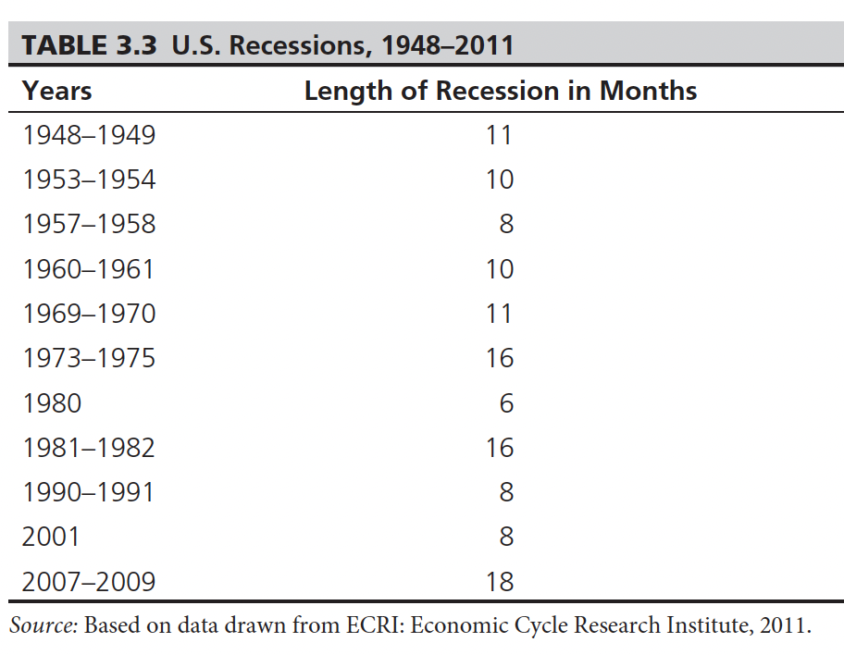
Short-term Economic Changes
The business cycle is a function of capitalistic economies
  Can be expansions or recissions

Slide 11
Manufacturing VS service
Big shifts over the decades
New push for high-tech manufacturing along with service
Skilled labor is a focus as globalization becomes a way of life

Slide 12
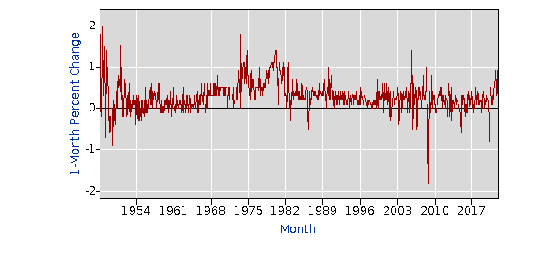
Economic Indicators
Gross National Product (GNP): A countries total economic output
Consumer Price Index (CPI): a measure of the price of goods and services
  The imaginary market basket
All items in U.S. city average, all urban consumers, seasonally adjusted
https://data.bls.gov/pdq/SurveyOutputServlet

Slide 13





Monitoring Cycles
Educational leaders must be aware of cycles
  The news
  Industry publications
  Sub-division reports
  Home sales

Slide 14
Right now…
What is the unemployment rate in the U.S.? How about inflation?
How about Mission-McAllen-Edinburg?
Home sales and building in the RGV?
Restaurants and retail figures?
Things are weird…
  “Pandemic recession stands apart from others: much sharper, shorter-lived decline and steeper recovery”
  “Unlike Great Recession, house prices soared”
  “Unusual for a recession, personal income rose” (Dallas FED, 2022
Notes:
4% 7.5% inflation - about 7% - there is a shortage – we’re still spending

Slide 15
Demographics
Long-term changes
  An aging population
  Minority majority
  Immigration and migration
  Suburbanization
Short term changes
  Child poverty level steady at about 20% until 2021 when it hit 12%, back to 17% now.,
  Home sale boom
  No pandemic baby boom
  “Texas job growth fueled by domestic migration, which accelerated in pandemic” (Dallas FED, 2022)

Slide 16

Why the Business Cycle matters
Budgets are driven by taxes
Booms and busts must be accounted for
Rarely do budget cuts come with less work to be done

Slide 17
That ask
“Do More with Less”
“Do a Lot More with a Little More”
“Do a Lot More with a Lot Less” (Fowler, 2013)

Slide 18
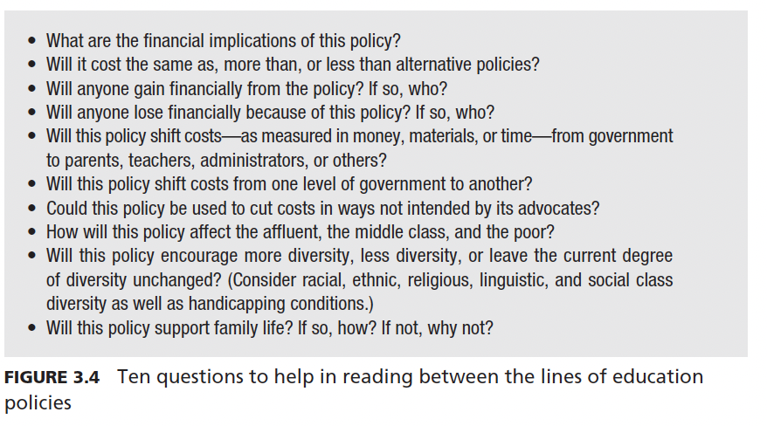
Reading between the lines
These topics are politically charged
Educational leaders have to read the tea leaves
(Fowler, 2013)

Slide 19
References
Dallas Federal Bank. (2022) 2022 Outlook. https://www.dallasfed.org/-/media/Documents/research/events/2022/22txoutlook.pdf
Fowler, F. C. (2013). Policy Studies for Educational Leaders: An Introduction. United States: Merrill.
U.S. BUREAU OF LABOR STATISTICS (2022) Custom Report. Https://Data.Bls.Gov/Pdq/Surveyoutputservlet

