Slide 1
History Timeline
Presented by Luis Alaniz

Slide 2
1787 - The Constitutional Convention
The convention met in Philadelphia between May and September 1787 to address shortcomings that stemmed from the Articles of Confederation.
The federal government was granted more authority with specific power including international relations, interstate commerce, federal laws, etc (Department of State, 2022).
Ratification took place in 1789.

Slide 3
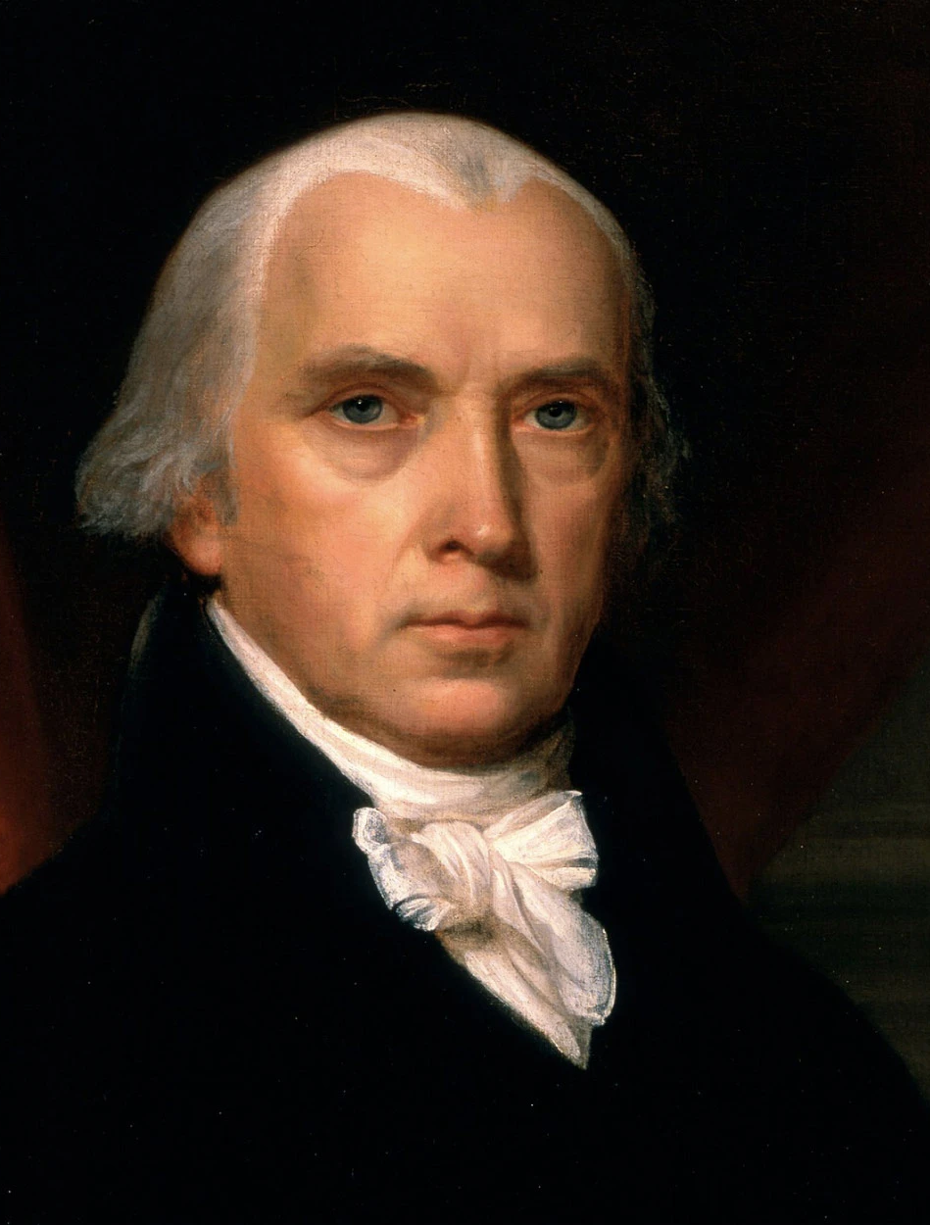
1787 - The Constitutional Convention - Views on Education
Education and a national university was advanced by delegates including James Madison –but it did not prevail (Alexander & Alexander, 2010).
Was an issue of federal versus state power more than about education.
Reshaped the look and balance of governance in the U.S. to this day.

Slide 4
1862 - The First Morrill Act
The First Morill Act was passed by congress in 1862 and provided an amount of land to each state to sell in return for proceeds that were earmarked for the
“endowment, maintenance and support of at least one college where the leading object shall be, without excluding other scientific and classical studies and including military tactics, to teach such branches of learning as are related to agriculture and mechanic arts in such manner as the legislatures of the states may respectively prescribe” (U.S.C.A., Title 20, Education, §§ 81–1686. as cited by Alexander & Alexander 2010).
This established land-grant colleges that were advancing the role of higher education in America
This also led to diversity in education which included agriculture and engineering
The federal role in education remained indirect

Slide 5
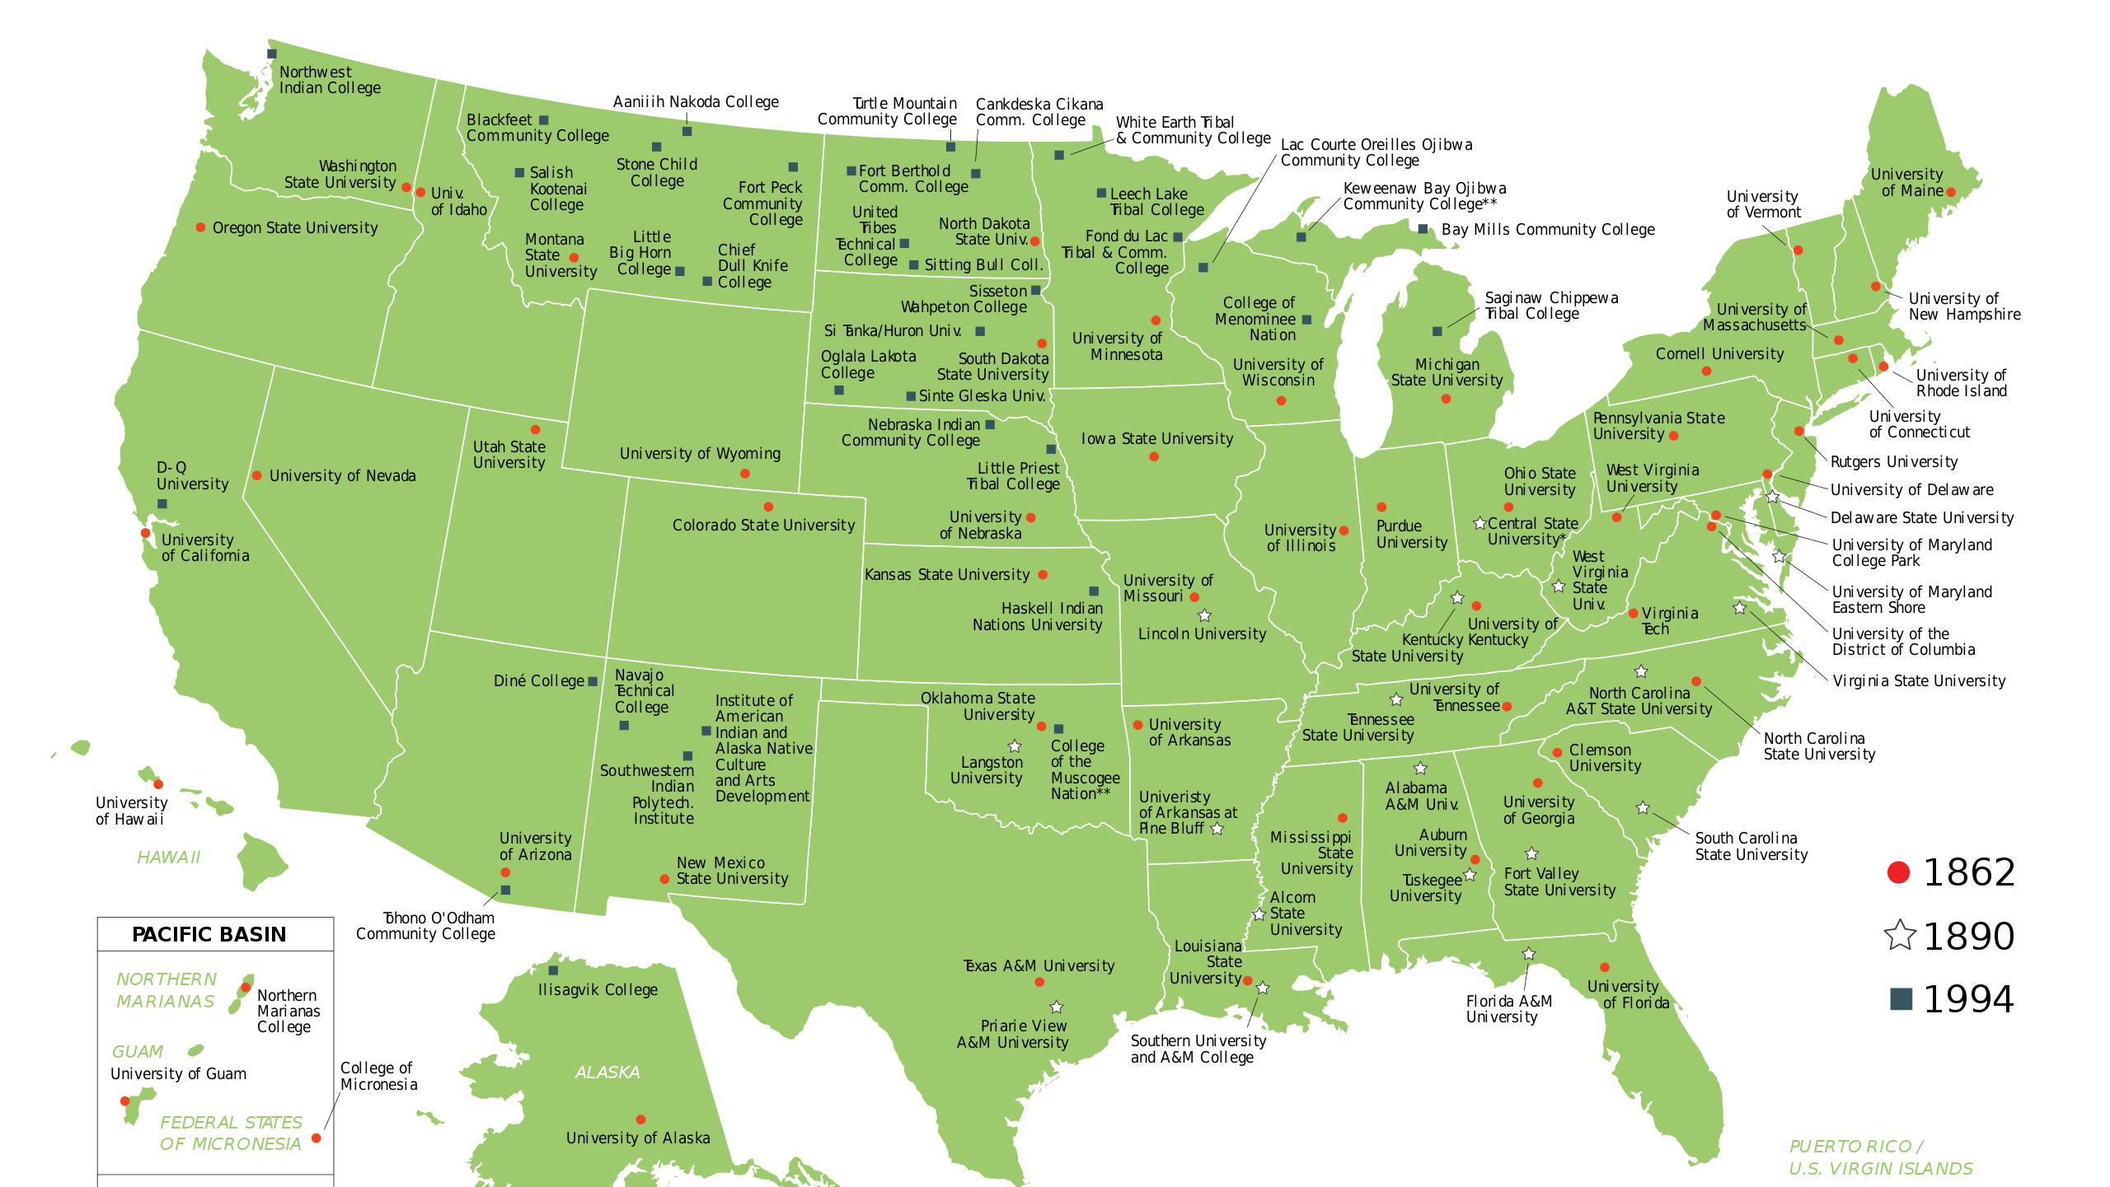

Slide 6
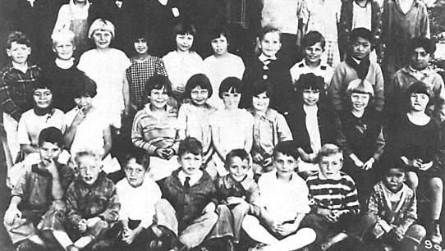
1931 - Alvarez vs. the Board of Trustees of the Lemon Grove (California) School District
Starts with the ”Lemon Grove Incident” –the attempt to segregate Mexican children
Predates Brown V Topeka
One of many cases in the American Southwest from the 30’s

Slide 7
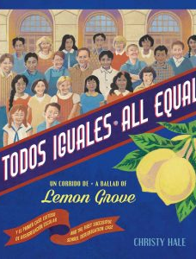
1931 - Alvarez vs. the Board of Trustees of the Lemon Grove (California) School District
The community took action and won the case –they were after equal education and not segregation
Segregation was supported at a state level as the California school code stated ” The power to establish separate school for Indian children and children of Chinese, Japanese and Mongolian ancestry” (Alvarez, 1984, para. 4) –Mexicans were deemed ”Indian.”
Was a shift in Black/White to Brown/White and POC/White paradigms (Madrid, 2008)

Slide 8
2016 – Transgender Bathroom
Obama administration called on public school districts to allow transgender students to use the bathroom which matches their gender identity as a condition of receiving federal funds (Dooley, 2016)
The Obama administration cited TITLE IX
While not law, it placed districts in a position where compliance was mandated and under the purview the Office of Civil Rights (Texas Association of School Boards, 2022).
OCR issued formal interpretation in 2021

Slide 9
References
Alexander, K., & Alexander, M. D. (2019). American Public School Law. (9 ed.) (Higher Education Coursebook). West Academic Publishing.
Alvarez, R. (1984). The Lemon Grove incident. The Journal of San Diego History
Department of State (2022). Constitutional Convention and Ratification, 1787–1789. https://history.state.gov/milestones/1784-1800/convention-and-ratification
Dooley, E. (2016). Obama to Public Schools: Allow Transgender Students Access to Bathrooms. https://abcnews.go.com/US/obama-administration-public-schools-transgender-students-access-bathrooms/story?id=39081956
Madrid, M. (2008). The Unheralded History of the Lemon Grove Desegregation Case. Multicultural education magazine.
(2002) Legal Issues Related to Transgender Students. Texas Association of School Boards. TASB School Law eSource.

