Slide 1
Martha Treviño
Oral History Project
Presented by Luis Alaniz

Slide 2
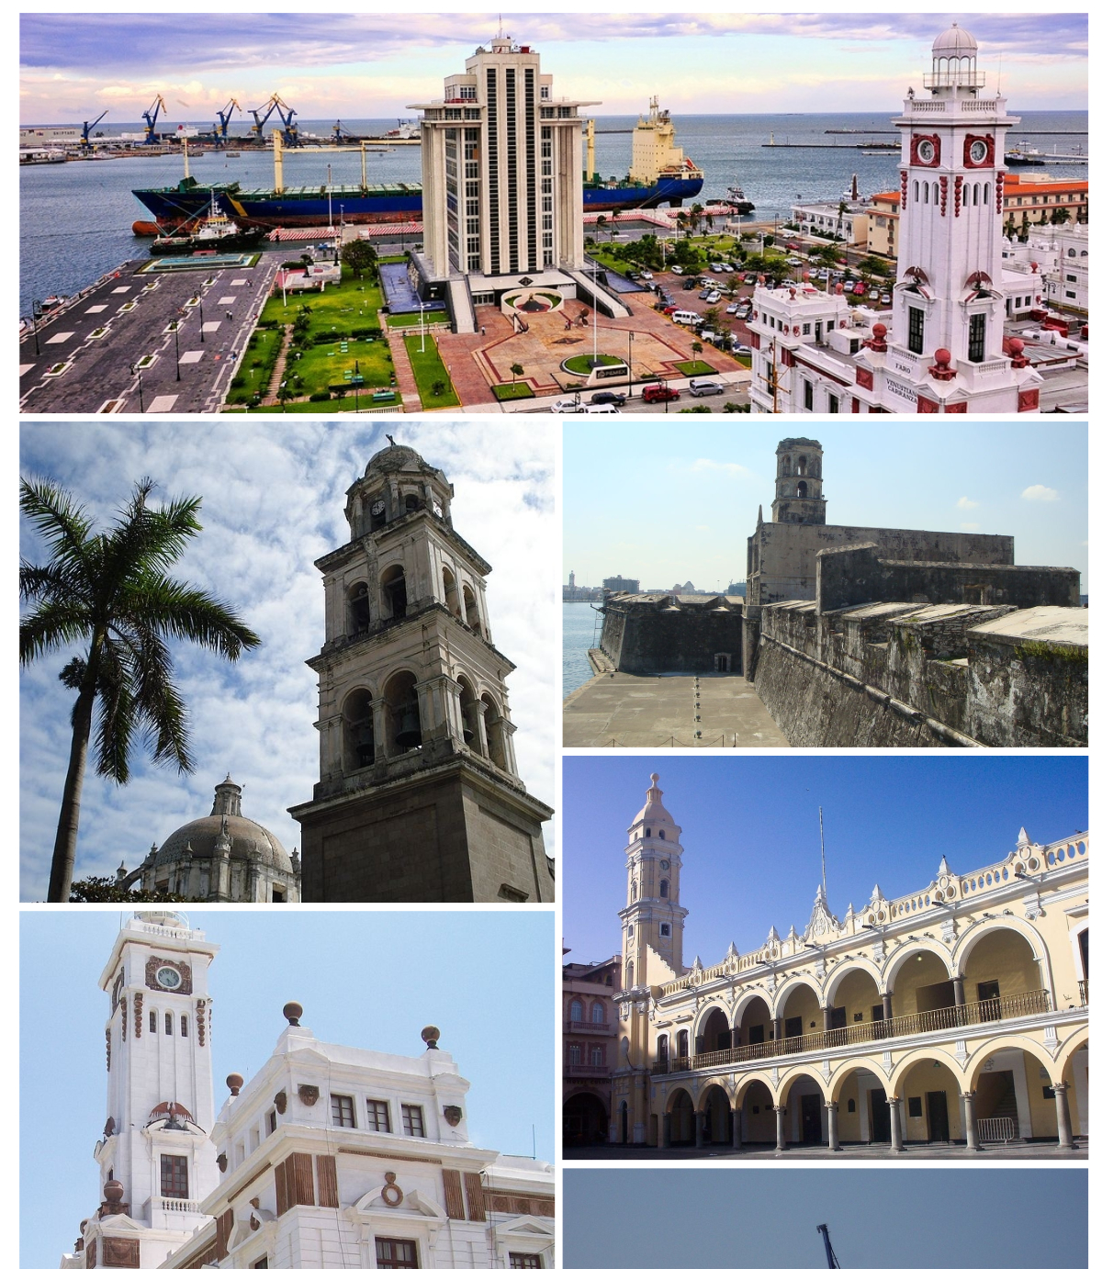
Early life
Born in Veracruz, Mexico
Parents separated
Moves to the U.S. border
Begins life an ESL student
Eldest of 7 with 5 half-siblings

Slide 3
Highschool to college
Little support in her high school classes
Counseling virtually non-existent
ESL challenges
GED
Push for more
Love of reading and writing

Slide 4
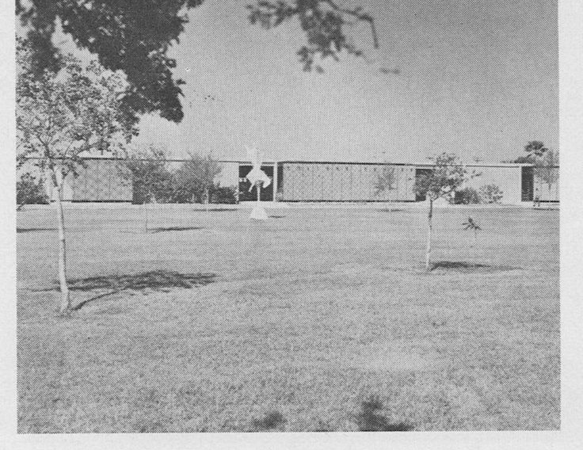
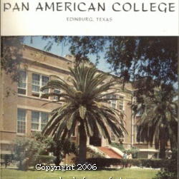
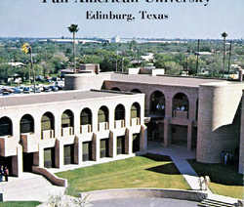
College
Marriage to an Army veteran who took advantage of the GI bill
Housemaker while her husband attended university
Attended college at Pan-American College Brownsville
Little support for families in terms of housing, care, jobs, etc
Moved from Brownsville to La Joya for the support system
Attended Pan-American College Edinburg
Safety was a constant concern
Gender biases
Still little support from the institution
Was a big basketball fan and still misses the Broncs

Slide 5
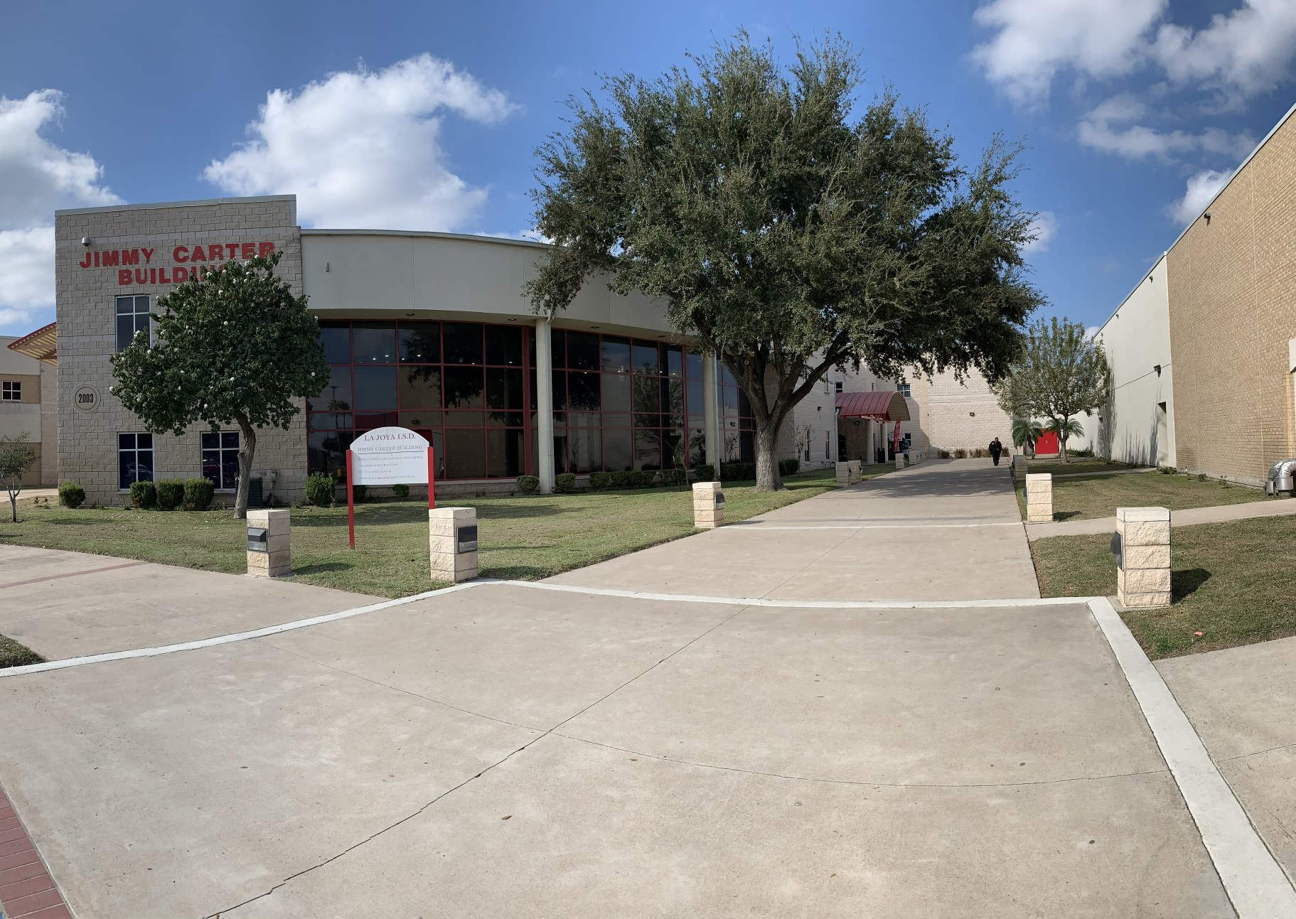
Post bachelor’s
Taught elementary and elementary GT
Worked on master’s degree in the early 90’s
Spanish high school teacher
Saw shift in student population
Shifts in ESL programs/support
Combined her love of language and teaching by becoming La Joya ISD grant development coordinator
Worked to secure support and funding for the district’s first early college and expand dual enrollment opportunities

Slide 6
Legacy
Retired, moved
Despite health issues, she offered me dissertation help –the day I got admitted to the program
Recommendations carry weight
Servant leadership

