Slide 1
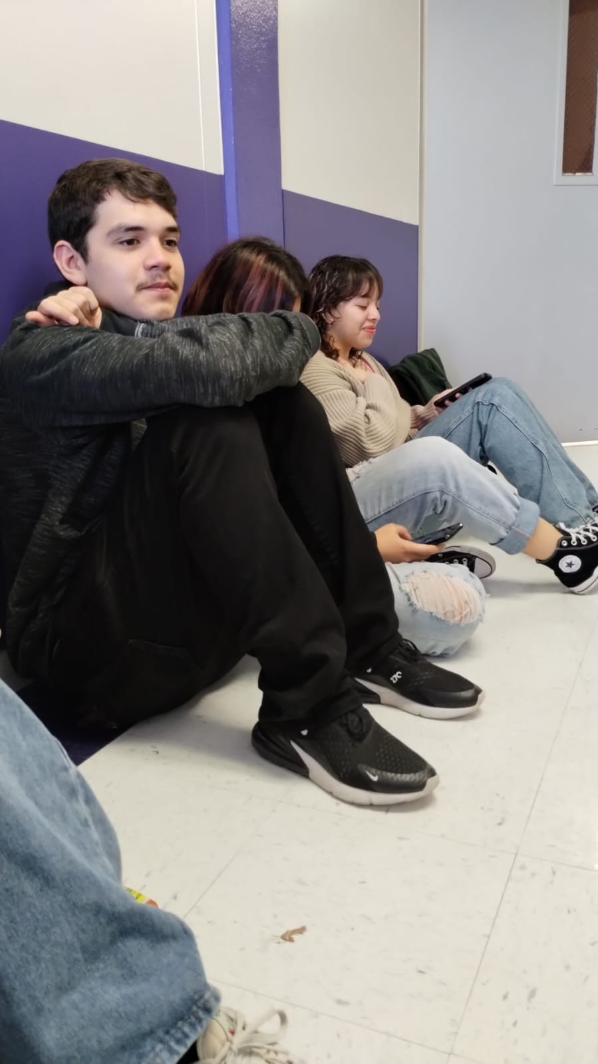
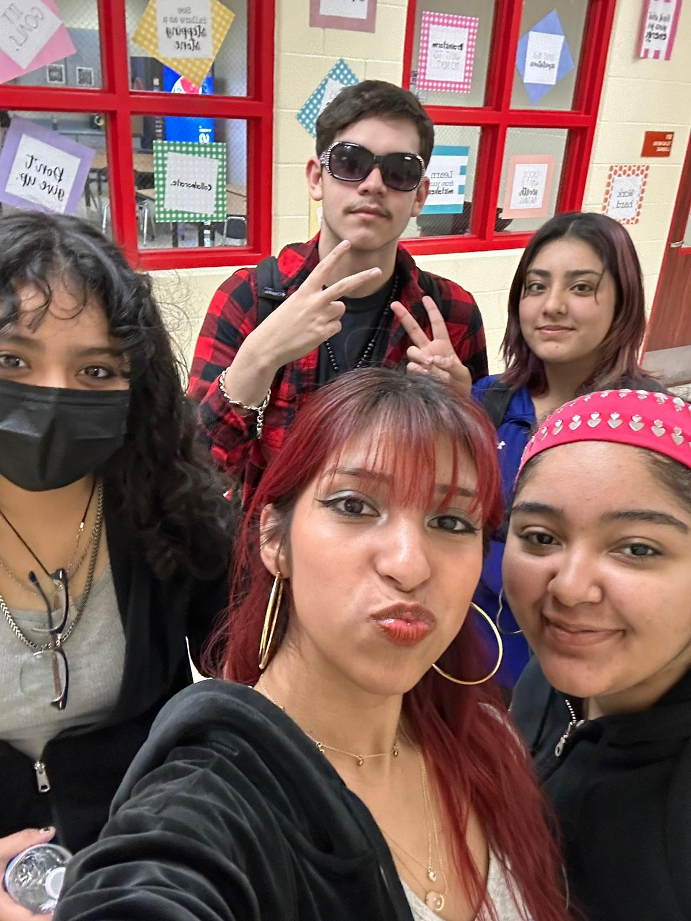
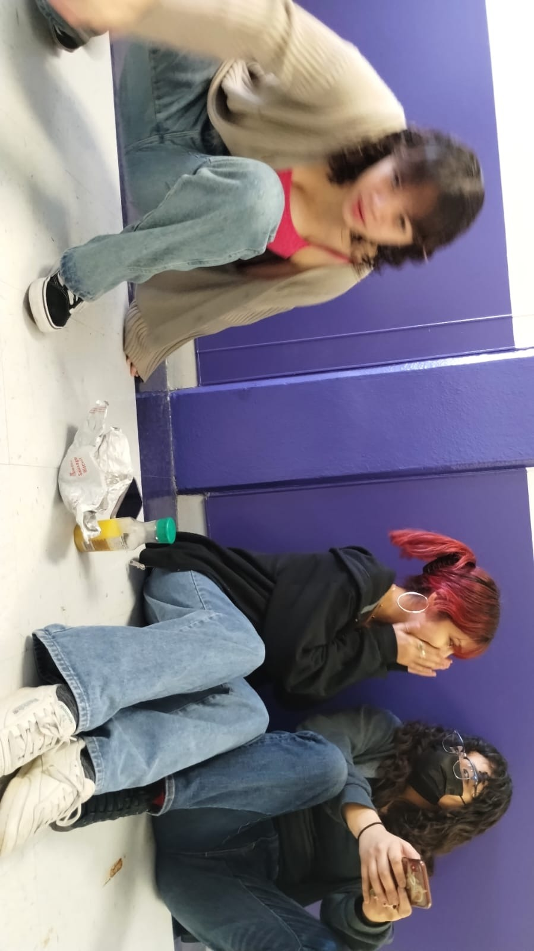
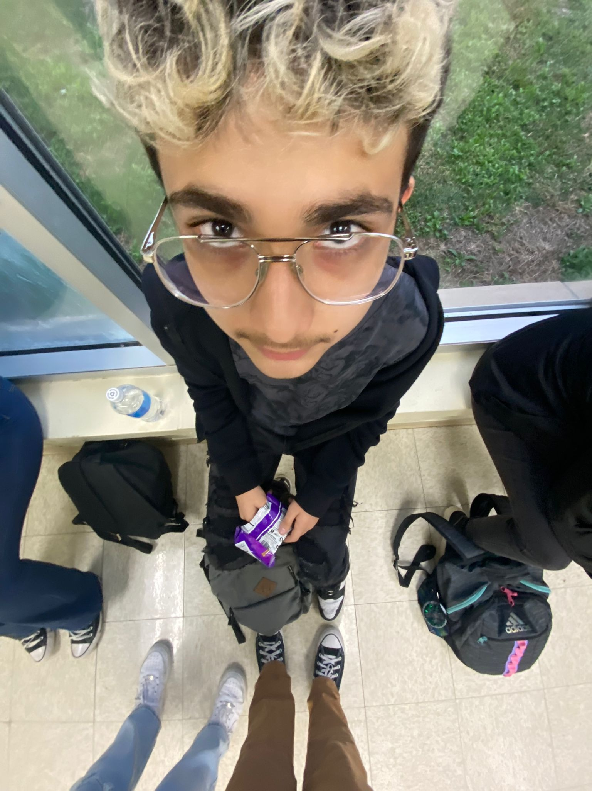
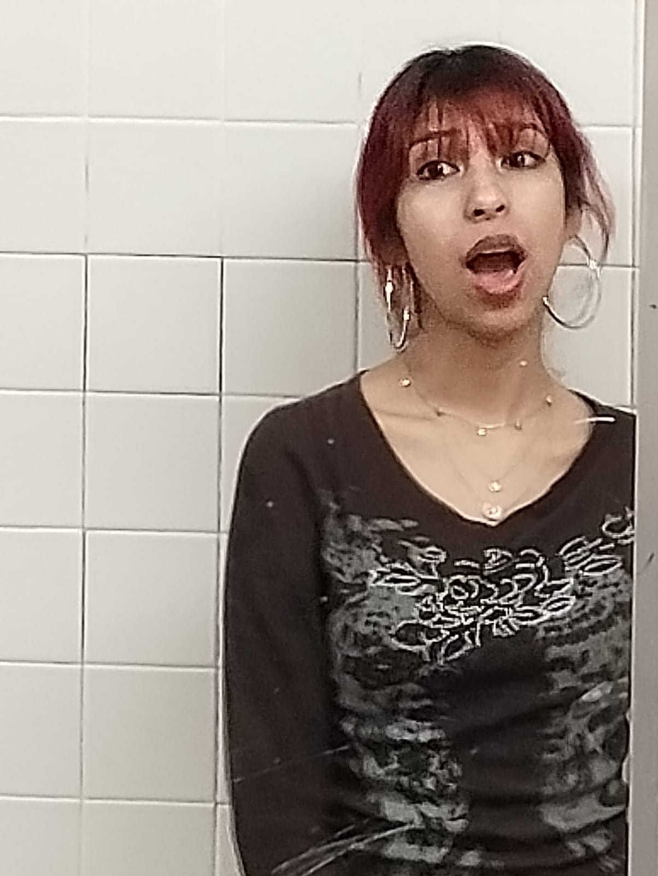
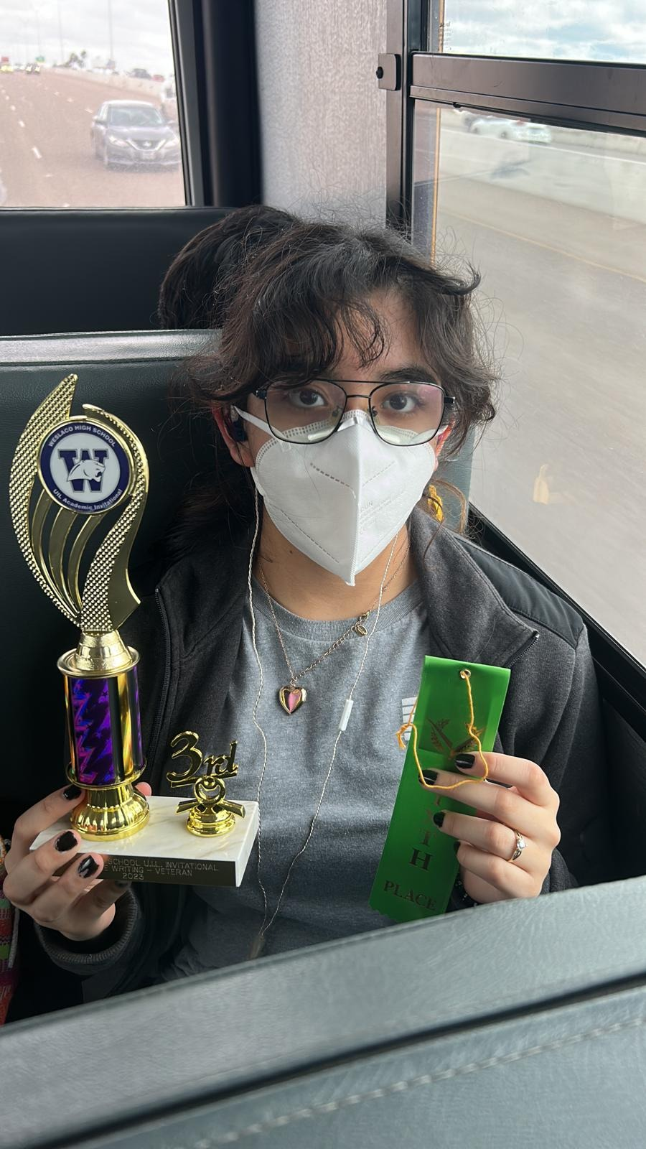
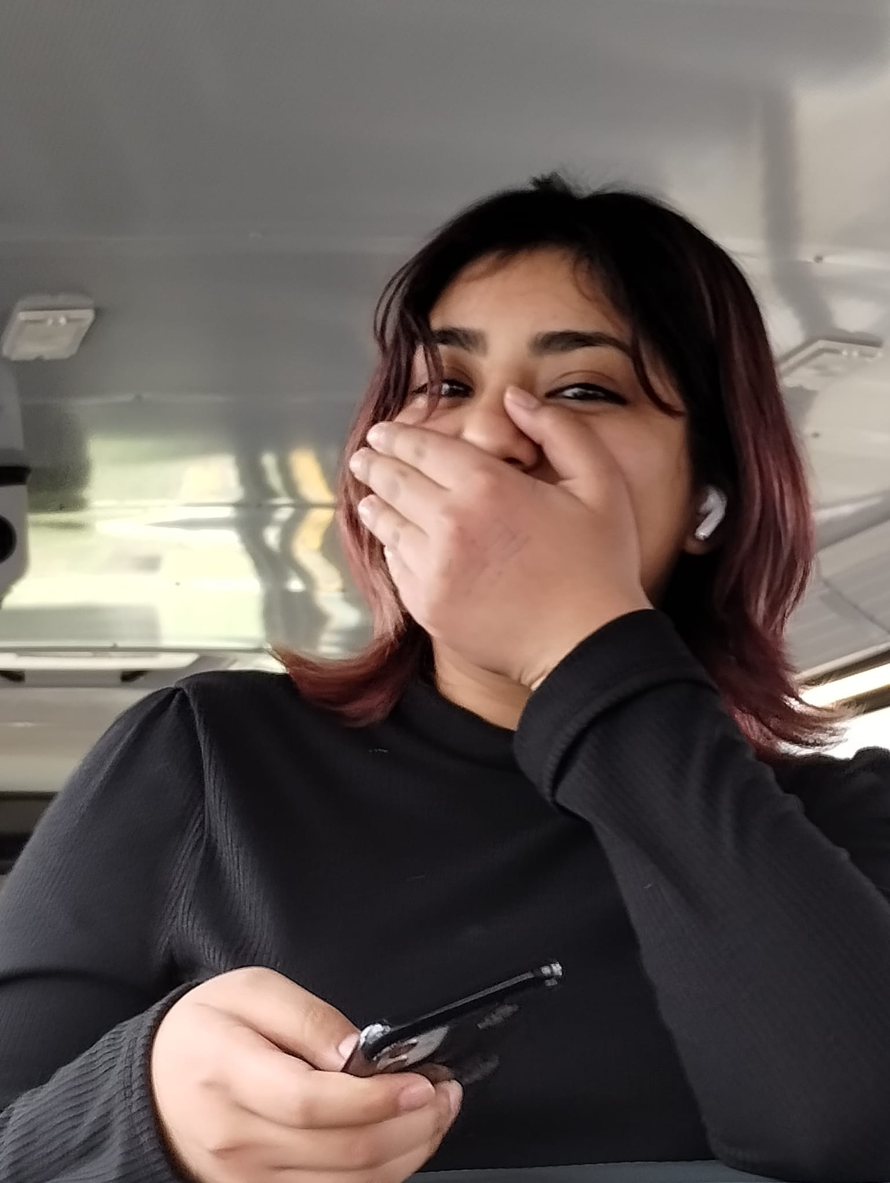
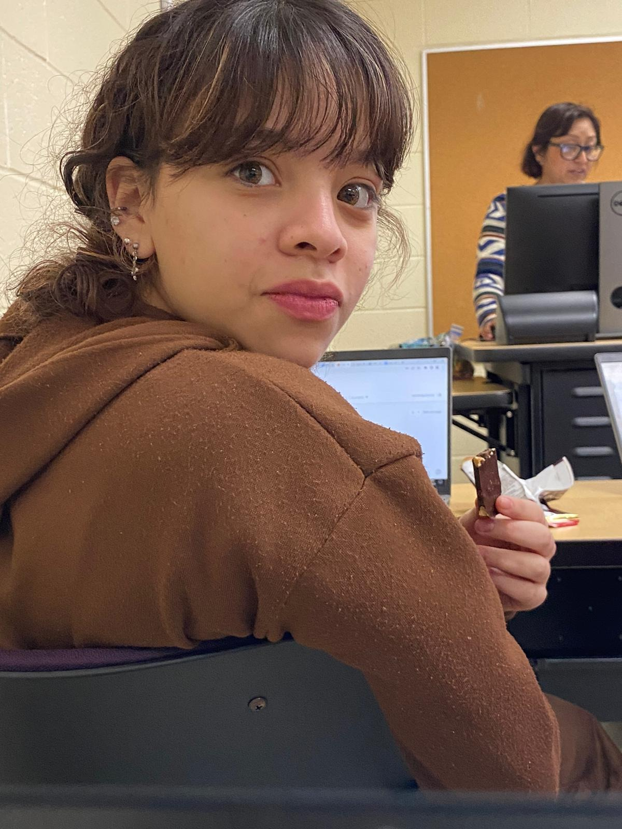
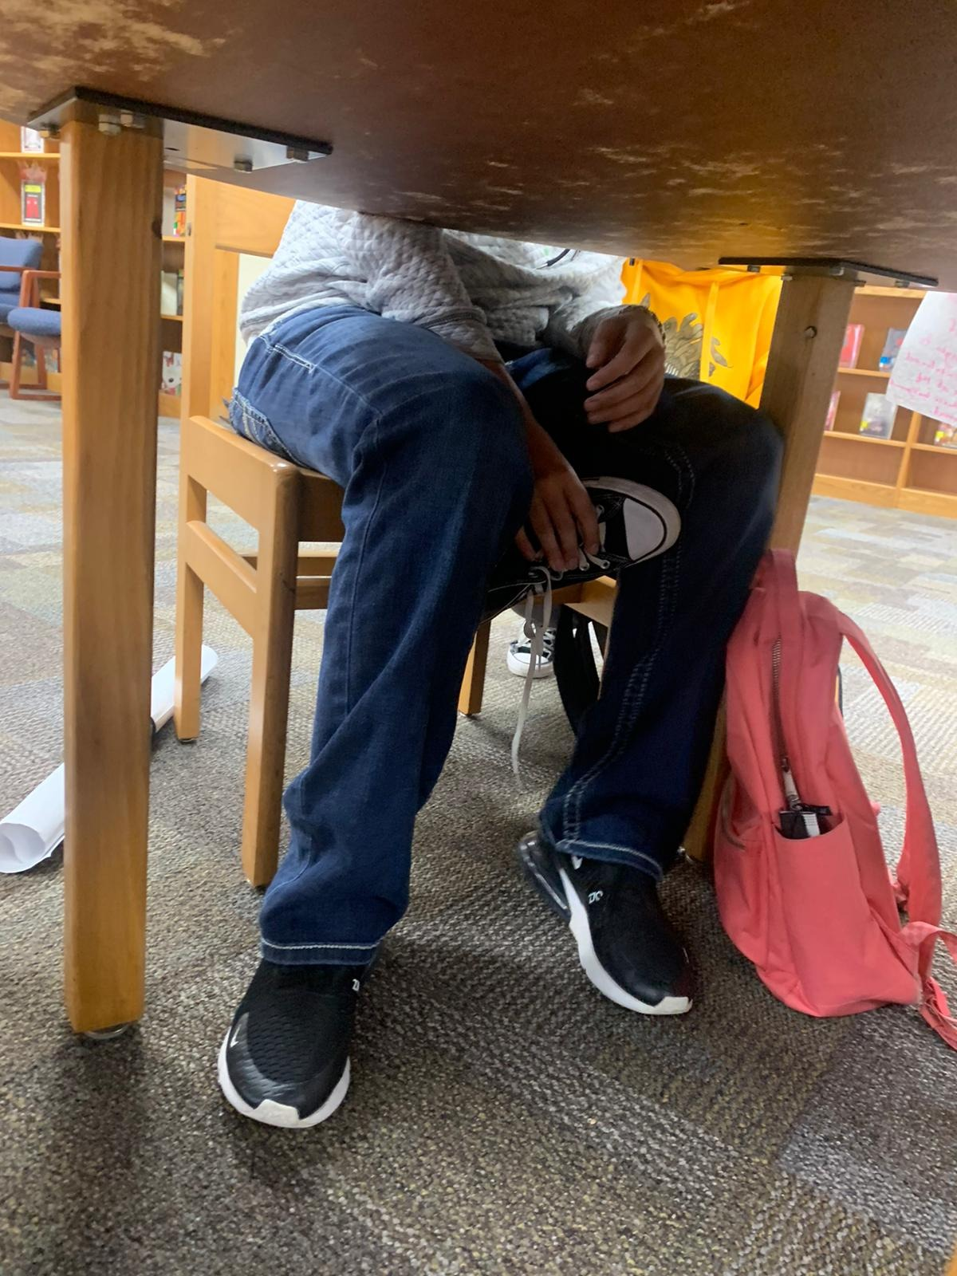
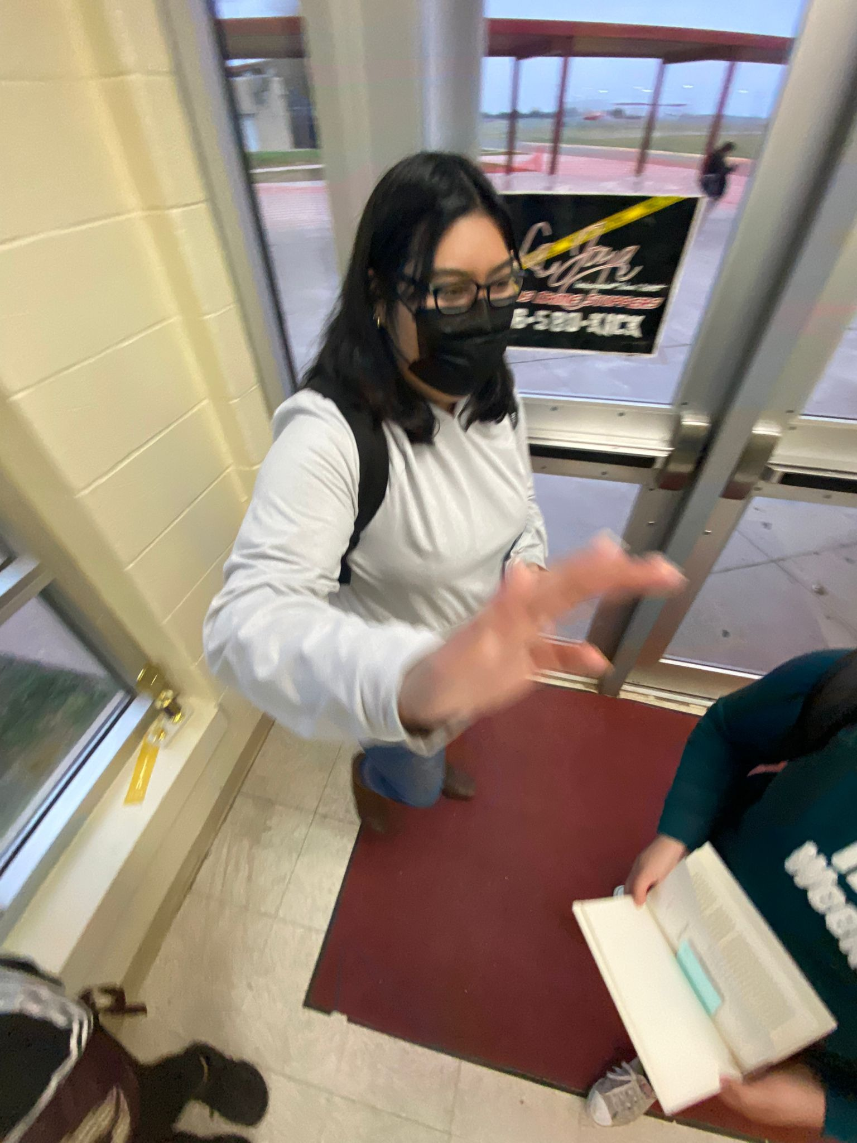
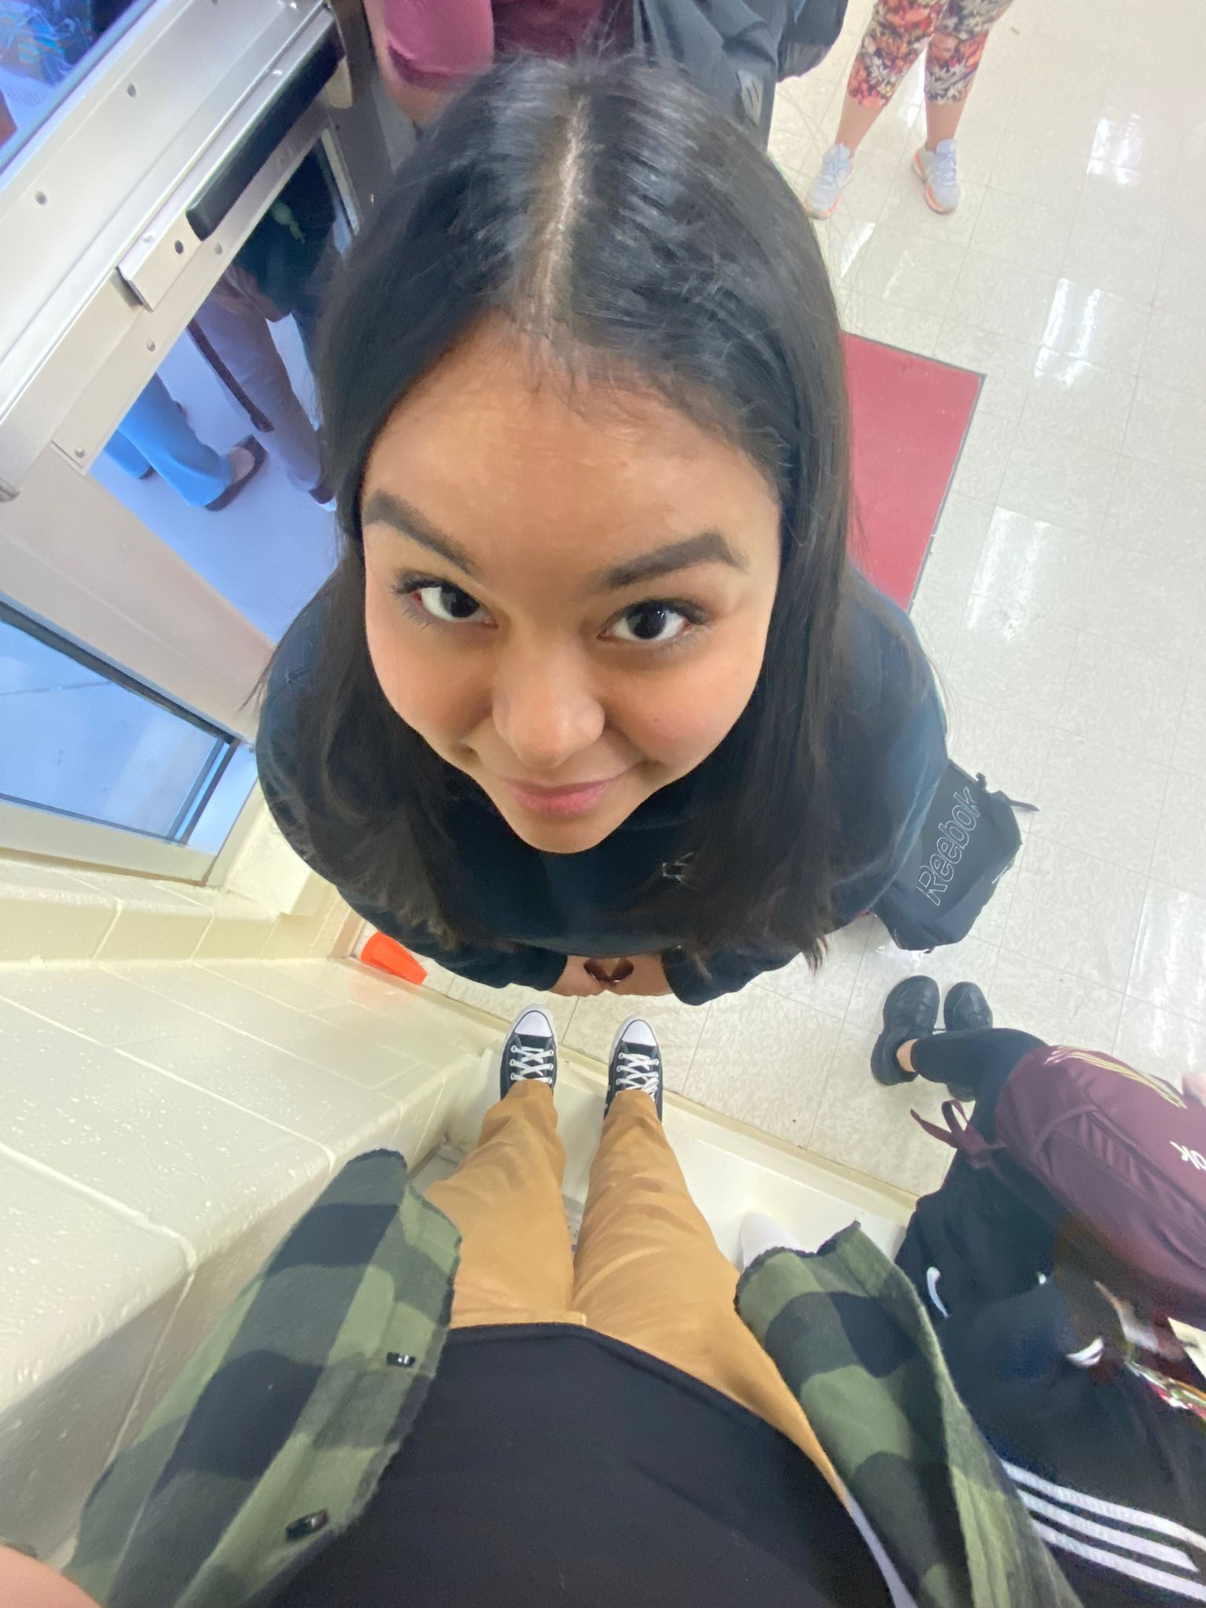
The Team
Leo
Ruby
Adilene
Karyme
Aylin
Beto
Saray
Francisca
Notes:
Leo, get on the bus
Francisca, if wasn’t your week
Saray, same
Beto, you did well but people are out-growing you, kick it up
Aylin, good job, keep working on it
Karyme, you’re right where you need to be
Adilene, a little inconsistent, but you’re a winner
Ruby, well done this week
Team

