Slide 1
Integrative Education Modifying General Education
Presented by Luis Alaniz

Slide 2
Integrative Education
Is a framework for learning from multiple sources, along with critical thinking, values development, and respect for cultural and opinion differences
It is a holistic approach and not limited to associate degrees
Integrative education can be applied to both occupational and university preparation but is not widely incorporated in practice
The concept of integrative education aligns particularly well with community education
(Cohen et al., 2013)

Slide 3
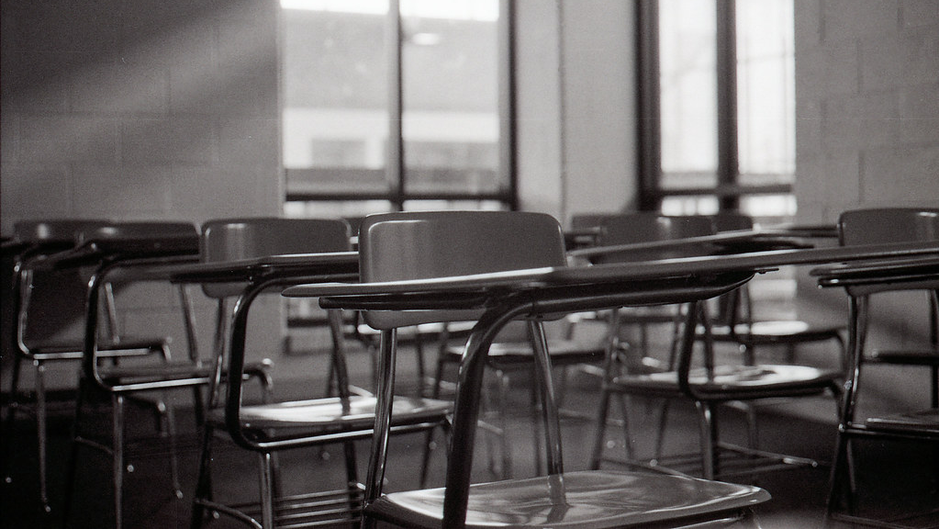
General Education
The term "general education" was originally used to describe integrative education but has since become synonymous with “core” requirements (Humanities, Mathematics, Natural Sciences, Social Sciences, English, Foreign Languages, and Fine Arts)
Essentially a combination of technical competence and social understanding
The President's Commission on Higher Education (1947) and the President Dwight Eisenhower's Committee on Education Beyond High School (1957) both emphasized the importance of general education in combination with semiprofessional training.
(Cohen et al., 2013)

Slide 4
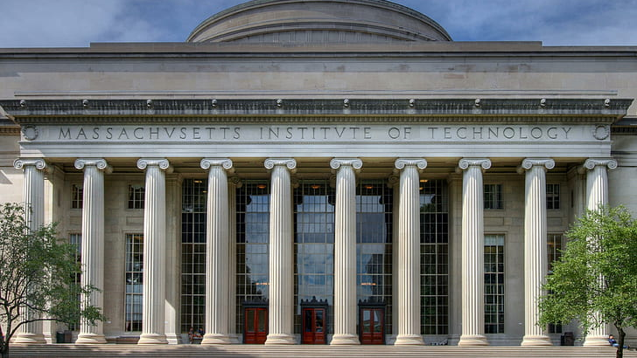
Rise and Fall of General Education
General education has a long history, originating from moral philosophy courses taught in early American colleges –typically by college presidents and available to all students.
In the second half of the 19th century, the classical curriculum died out and was replaced by a free-elective system.
Departments took the lead for outlining supporting courses.
(Cohen et al., 2013)

Slide 5
A 1950s study in California community colleges listed 12 competencies for a person considered "generally educated."
“
Exercising the privileges and responsibilities of democratic citizenship;
Developing a set of sound moral and spiritual values by which he guides his life;
Expressing his thoughts clearly in speaking and writing and in reading and listening with understanding;
Using the basic mathematical and mechanical skills necessary in everyday life;
Using methods of critical thinking for the solution of problems and for the discrimination among values;
Understanding his cultural heritage so that he may gain a perspective of his time and place in the world;
Understanding his interaction with his biological and physical environment so that he may adjust better to and improve that environment;
Maintaining good mental and physical health for himself, his family, and his community;
Developing a balanced personal and social adjustment;
Sharing in the development of a satisfactory home and family life;
Achieving a satisfactory vocational adjustment; and
Taking part in some form of satisfying creative activity and in appreciating the creative activities of others.
”
(Cohen et al., 2013)

Slide 6
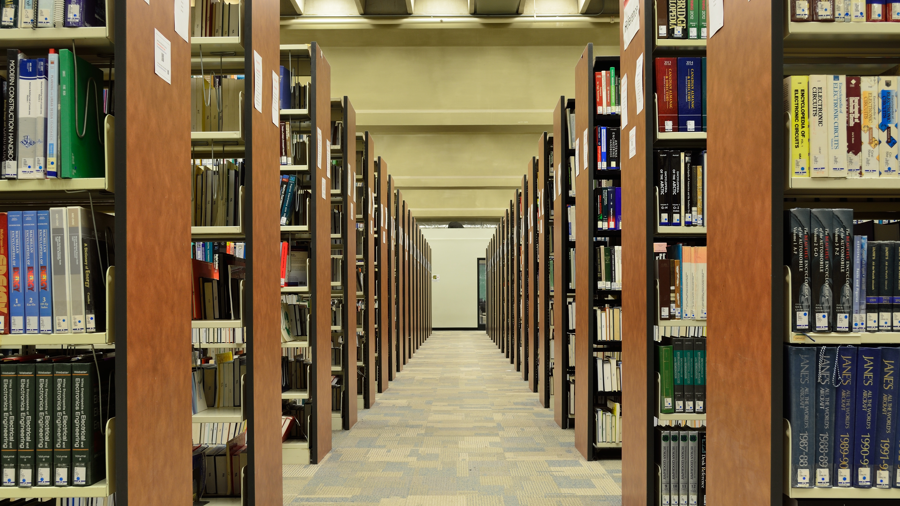
Hard to Explain
Explaining general education as “that which everyone should know” did not help it gain support.
Who is everyone? According to who? Who made the list and why? Is it responsive to diverse needs?
The focus on job creation has also become a hinderance.
(Cohen et al., 2013)

Slide 7
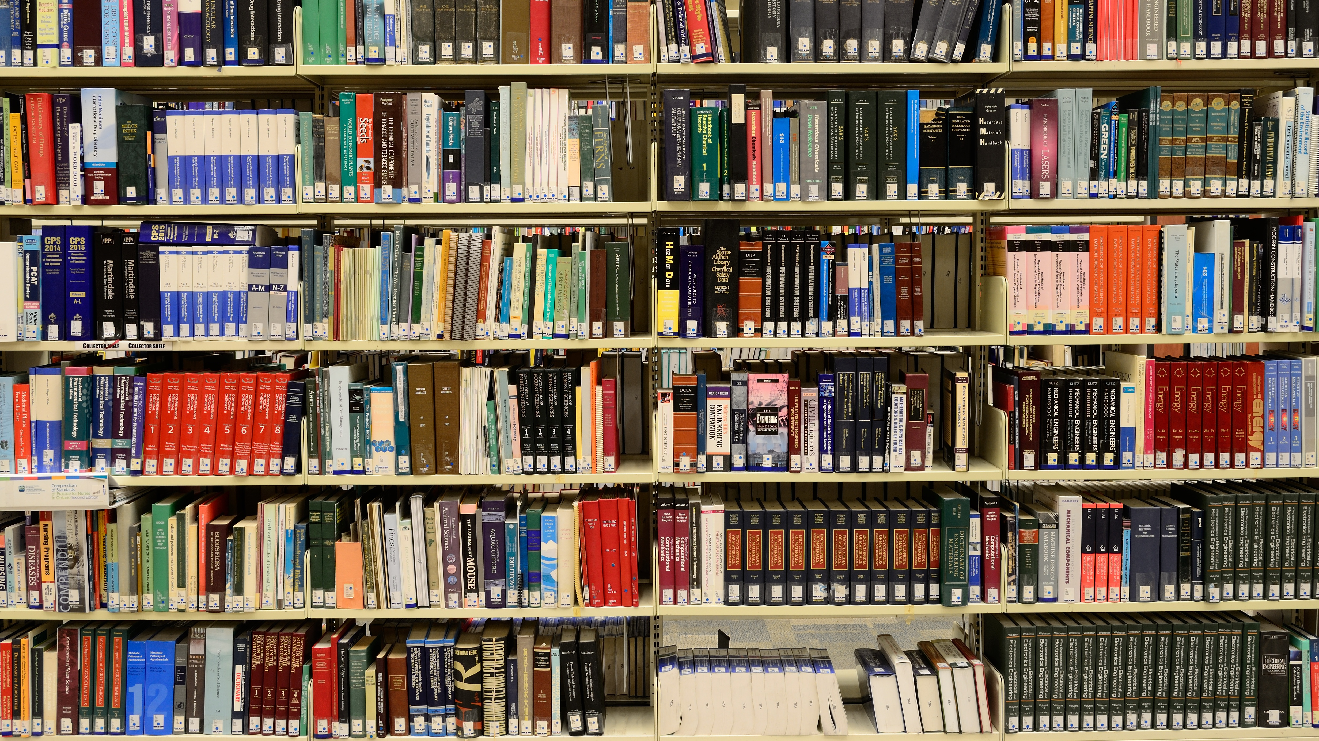
Taking the next steps
If CCs were to change their practices, they would have to carefully consider course construction and how to approach negotiations with universities that accept transfers
The bases for this transformation exist in the form of
Critical thinking
Service learning
Civic engagement
Sustainable development courses and activities
These elements can be combined to create new programs that align with what general education proponents have been wanting
(Cohen et al., 2013)

Slide 8
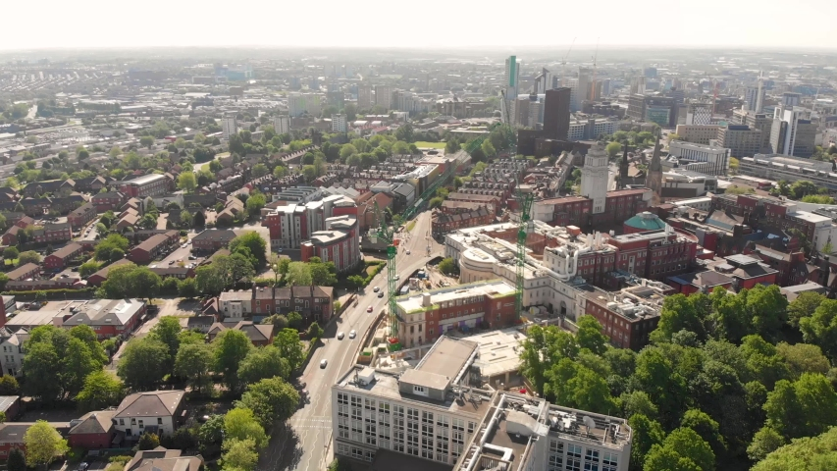
Critical Thinking
Critical thinking has been promoted as a core aspect of integrative education for decades.
It has various definitions, including tying it to the thinking process used by professionals in a discipline, promoting open-mindedness, and aiming for well-founded judgment.
It is linked with creative thought and is considered a quality that can be taught and learned.
Critical thinking is crucial to faculty development, outcomes assessment, and college culture evolution.
It is familiar to instructors who have studied academic disciplines and is central to writing improvement efforts.
It has been linked to Writing Across the Curriculum and efforts to elevate community college instruction to a higher level.
The concept has been examined from numerous viewpoints and numerous ways of introducing and sustaining it in community colleges have been reviewed.
Assessing critical thinking is difficult, but there are standardized instruments available, such as the Watson-Glaser Critical Thinking Appraisal.
(Cohen et al., 2013)

Slide 9
Service Learning
Service learning was introduced as a way to integrate the liberal arts into society and address the growing disparity between the two.
Service learning is a combination of community service and classroom instruction, emphasizing critical and reflective thinking and personal and civic responsibility.
In 2012, two-thirds of community colleges offered service-learning curricula.
The most common engagements for students included tutoring and mentoring, social and health services, environmental efforts, and senior centers.
Participating students tend to have higher enrollment and graduation rates than non-participants.
(Cohen et al., 2013)

Slide 10
Civic Engagement
A process of developing skills, habits, and values through experiences, exploration, and bonding with others who share a civic purpose.
Community colleges provide opportunities to engage in democracy and preparing them for life and work in their communities and in a democratic society.
Civic engagement helps students develop employability skills, critical thinking, values, and cultural awareness.
It also helps connect what students learn in the classroom to real-world experiences and issues.
(Cohen et al., 2013)

Slide 11
Sustainable Development
Sustainable development encompasses various areas, including biological, economic, and social aspects, and is based on environmental sustainability, improved quality of life, renewable resource use, ecological economics, and the idea of "progress as if survival matters"
The goal of sustainable development is to improve the quality of life for everyone and foster stewardship of sustainable resources
Colleges and universities have initiated various sustainability projects, but long-term success requires on-site champions
(Cohen et al., 2013)

Slide 12
References
Cohen, A. M., Kisker, C. B., Brawer, F. B. (2013). The American Community College. Germany: Wiley.

